Slide 1



The F# Path to Relaxation
Don Syme, F# Community Contributor, Microsoft Researcher

Slide 2


Hello Siberia!!!

Slide 3
A Gentle Stroll Through the Land of Language Design and Delivery

Slide 4
A starting position…. Great disputes should be struggled with They are chances to make a simpler, better, more relaxed world

Slide 5
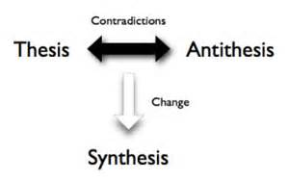
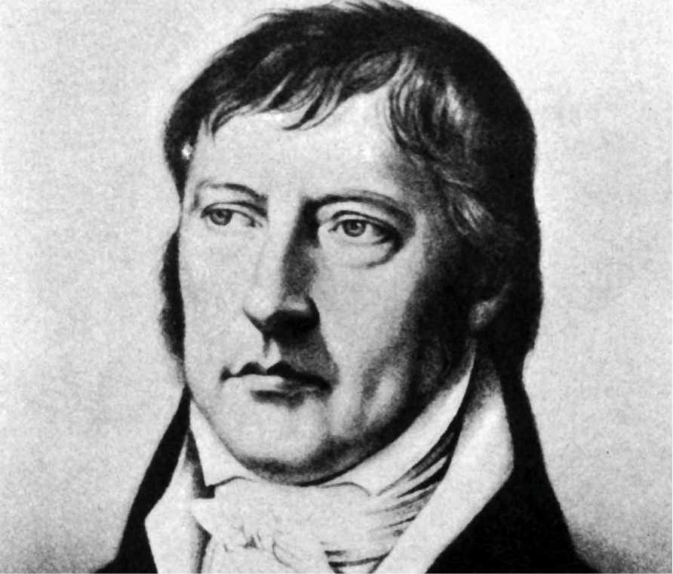
Not a new idea…
The Hegel

Slide 6
X
Y
?

Slide 7
Functional
Interop

Slide 8
Way back in time….. 2003 Functional languages were isolated, non-interoperable, using their own VMs. Interop standards like C-calls, COM, CORBA, XML were a mess for language-integration.

Slide 9
The F# Approach (also Scala, Swift, …) Embrace industry-standard runtime layers, and influence them. Design for end-to-end interop. Compromise where needed.

Slide 10
For more! The Early History of F# - HOPL IV (2021) fsharp.org/history

Slide 11
Roll forward to today!

Slide 12
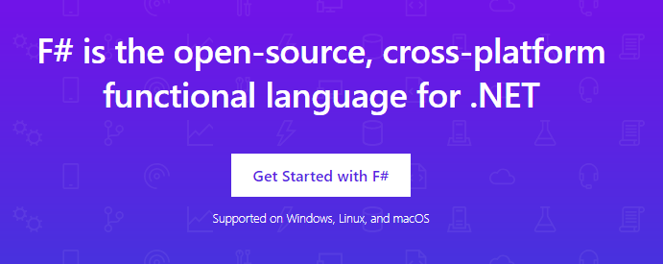
www.microsoft.com/net/

Slide 13
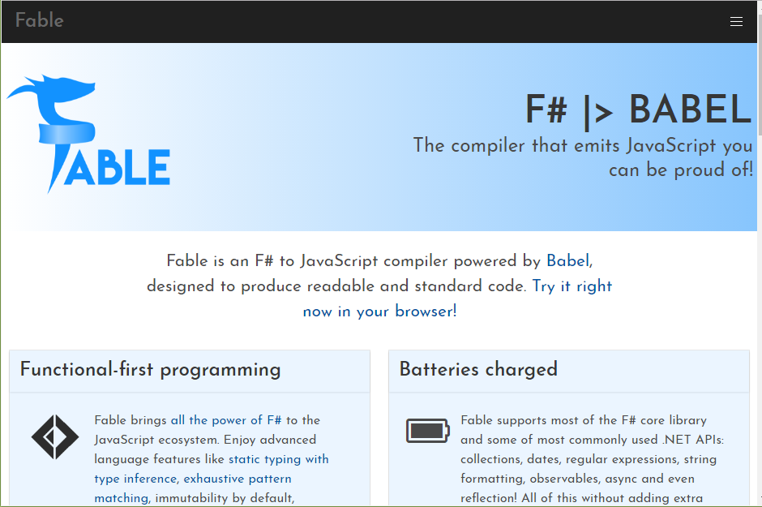

Slide 14
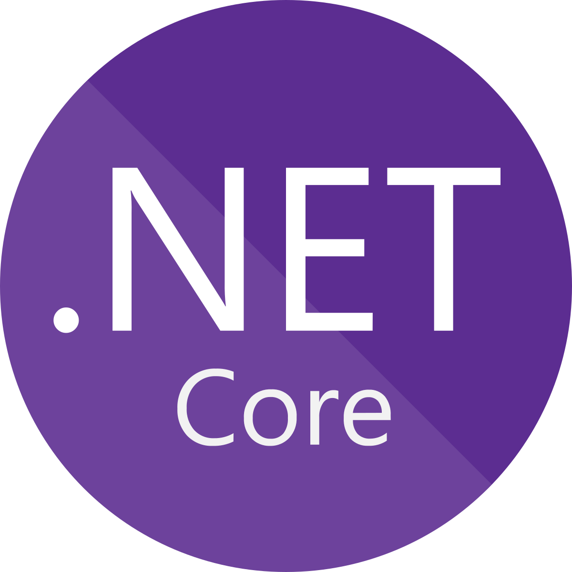





F# get started dotnet new -lang F# dotnet build

Slide 15
F# get started dotnet new -lang F# dotnet build
F# tools are part of the .NET SDK, available everywhere

Slide 16

F# for the backend dotnet new -i "giraffe-template::*" dotnet giraffe
A functional ASP.NET Core micro web framework for building rich web applications.
github.com/giraffe-fsharp/Giraffe

Slide 17
F# for the backend dotnet new -i "giraffe-template::*" dotnet giraffe
A functional ASP.NET Core micro web framework for building rich web applications.
High perf, functional server-side programming
github.com/giraffe-fsharp/Giraffe

Slide 18

F# for the frontend (JS) dotnet new -i "Fable.Template::*" dotnet new fable npm install npm start

Slide 19
F# for the frontend (JS) dotnet new -i "Fable.Template::*" dotnet new fable npm install npm start
You can use F# as a Javascript language

Slide 20


F# for the full stack dotnet new -i SAFE.Template dotnet new SAFE dotnet tool restore dotnet fake run
=
+

Slide 21

F# for the full stack
This powers real businesses including Norway’s NRK
=
+
@ooobject

Slide 22
A functional-first approach makes a huge difference in practice fsharp.org/testimonials

Slide 23
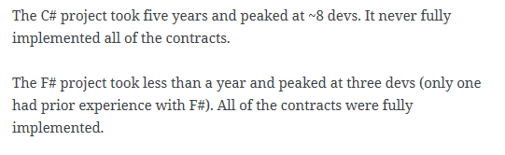
An analysis (Simon Cousins, Energy Sector)
350,000
lines of C# OO
by offshore team
30,000
lines of robust F#, with
parallel +more features
An application to evaluate the revenue due from Balancing Services contracts in the UK energy industry
http://simontcousins.azurewebsites.net/does-the-language-you-use-make-a-difference-revisited/

Slide 24
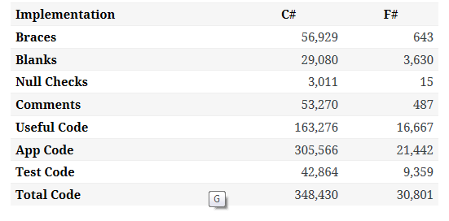

Slide 25
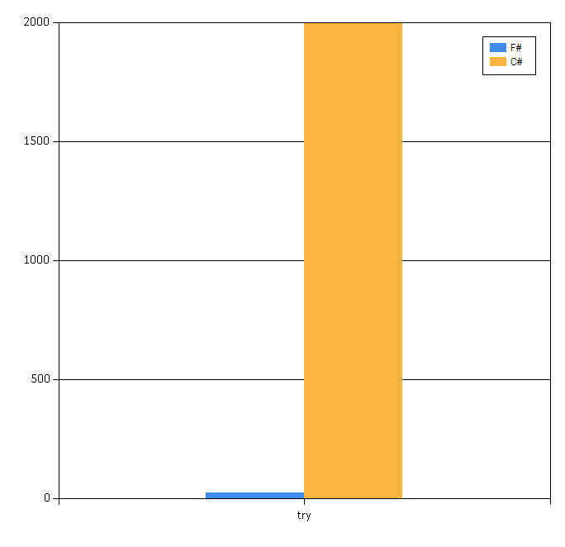

Slide 26
Simon Cousins, Energy Sector
Zero
bugs in deployed system
“F# is the safe choice for this project,
any other choice is too risky”
An application to evaluate the revenue due from Balancing Services contracts in the UK energy industry
http://simontcousins.azurewebsites.net/does-the-language-you-use-make-a-difference-revisited/

Slide 27
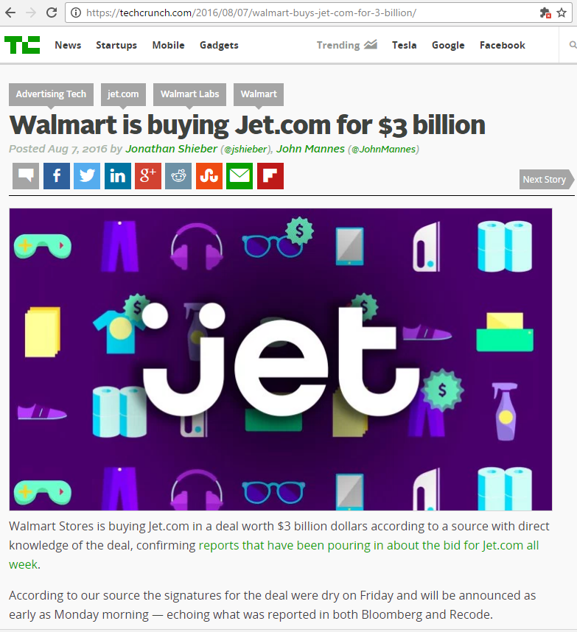
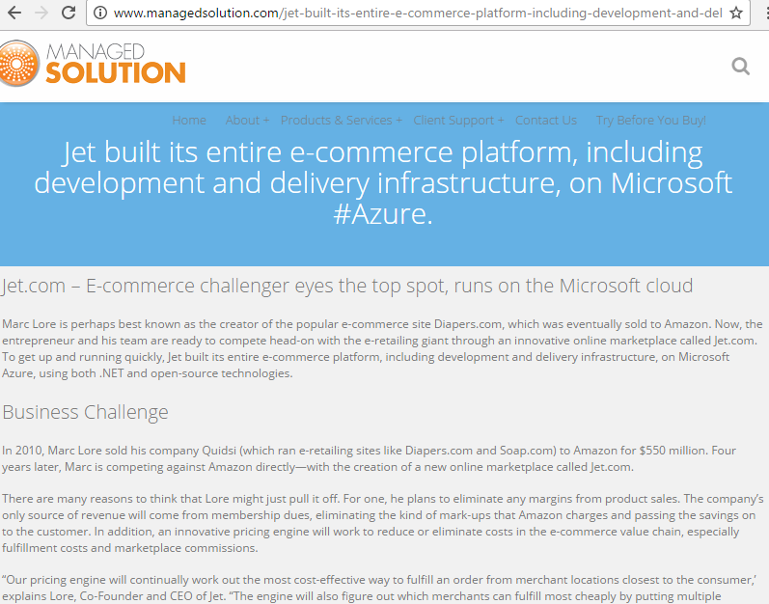
A $3B Unicorn, Built on F#

Slide 28
Relaxation Achieved, 200% ✔ ✔ Today’s FP languages are interoperable ✔ Today’s FP languages are practical
Functional
Interop

Slide 29
X
Y
?

Slide 30
Enterprise
Openness

Slide 31
TL;DR – Where we are now
F# is open, cross-platform, neutral, independent
The F# Compiler Service at the core
F# 5.0 now complete!
.NET Interactive Notebooks for Everywhere
All F# language and tooling is accepting contributions
Fable for F#-to-Javascript
SAFE for F# fullstack
The F# community is very “self-empowered”
fsharp.org
Visual Studio Code for Everywhere
Visual Studio for Windows, Mac

Slide 32
The F# Language Design Process github.com/fsharp/fslang-design github.com/fsharp/fslang-suggestions

Slide 33
F# 5.0! (2021) ✔ #r nuget packages in scripts “#r "nuget: Newtonsoft.Json" ✔ Jupyter and .NET Interactive notebooks! ✔ string interpolation ✔ nameof ✔ applicatives syntax in computation expressions ✔ improved .NET interop ✔ improved Map/Set performance + more
https://github.com/fsharp/fslang-design/tree/master/FSharp-5.0

Slide 34
The F# Compiler Service fsharp.github.io/FSharp.Compiler.Service

Slide 35
Relaxation Achieved ✔ Enterprise Quality + Openness + Community + Tooling + Ecosystem + Evolution Path = Goodness
Enterprise
Openness

Slide 36
X
Y
?

Slide 37
Functional
Objects

Slide 38
Then (2003) In the 1990s functional languages were historically anti-OO “Modern Compiler Implementation with Standard ML” - Chapter 14, Object Oriented Programming object – to express a dislike or distaste for something

Slide 39

F# : Objects + Functional = ️
type Vector2D (dx:double, dy:double) =
let d2 = dx*dx+dy*dy
member v.DX = dx
member v.DY = dy
member v.Length = sqrt d2
member v.Scale(k) = Vector2D (dx*k, dy*k)
Inputs to object
construction
Object internals
Exported properties
Exported method

Slide 40
Objects
Constructed Class Types
type ObjectType(args) =
let internalValue = expr
let internalFunction args = expr
let mutable internalState = expr
member x.Prop1 = expr
member x.Meth2 args = expr
Object Expressions
{ new IObject with
member x.Prop1 = expr
member x.Meth1 args = expr }
{ new Object() with
member x.Prop1 = expr
interface IObject with
member x.Meth1 args = expr
interface IWidget with
member x.Meth1 args = expr }
Object Interface Types
type IObject =
interface ISimpleObject
abstract Prop1 : type
abstract Meth2 : type -> type

Slide 41
Object Programming focuses on … succinct coding, notational convenience API ergonomics good naming practical encapsulation sensible, small, composable abstractions expression-oriented making simple things out of (potentially complex) foundations

Slide 42
Object-Oriented Programming too often means… objects as a single paradigm overuse of hierarchical classification (Animal, Cat, Dog, AbstractJellyBeanFactoryDelegator) large abstractions with many holes and failure points declarations not expressions complex things by inheriting from complex things…

Slide 43
The F# approach is to embrace object programming but not full “object-orientation”

Slide 44
Positive Synthesis Achieved ✔ some limitations remain… and there is one area in particular that’s worth discussing….
Functional
Objects

Slide 45
X
Y
?

Slide 46
Code
Data

Slide 47
We are living through an information revolution

Slide 48
We need to bring information into the language… At internet-scale, strongly tooled, strongly typed

Slide 49
Paradigm Locator
Statically Typed
Dynamically Typed

Slide 50
Enter F# Type Providers…. “Just like a library” “A design-time component that computes a space of types and methods on-demand…” “An adaptor between data/services and the .NET type system…” “On-demand, scalable compile-time provision of type/module definitions…”

Slide 51
https://fsprojects.github.io/FSharp.Data/images/json.gif

Slide 52
Relaxation Achieved ✔ ✔ F# Type Providers have been a hugely successful feature – their range of useful application is enormous. They bring data and typed programming into synthesis like no other feature around
Code
Data

Slide 53
X
Y
?

Slide 54
Async
Simplicity

Slide 55
Pattern Matching
Abstraction

Slide 56
In Conclusion

Slide 57
F# is a magical language It makes programming simple, logical and enjoyable

Slide 58
Remember the Hegel!

Slide 59
Help achieve relaxation today Where there is conflict, find a positive, creative path forward Freedom and relaxation are possible!

Slide 60
Thank you!! Questions?

